Slide 1
Artificial Intelligence
Naïve Bayes Classifier
Notes:
Slides and exercises are inspired by Russell & Norvig AI Book, Stanford’s AI course and from Berkeley’s AI course

Slide 2
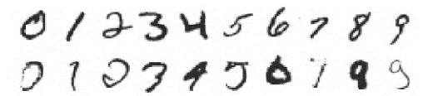
Machine learning
How to acquire a model from data / previous experience
Learning parameters (i.e. CPT tables)
Learning structure (i.e. BN graphs)
Learning hidden concepts (i.e. clustering)
Example: handwritten digit recognition
Notes:
Textbook chapter: Learning from examples

Slide 3
Inductive learning
In supervised learning the agent observes some example input–output pairs and learns a function that maps from input to output.
In unsupervised learning the agent learns patterns in the input even though no explicit feedback is supplied. The most common unsupervised learning task is clustering: detecting potentially useful clusters of input examples.
For example, a taxi agent might gradually develop a concept of “good traffic days” and “bad traffic days” without ever being given labeled examples of each by a teacher.
In reinforcement learning the agent learns from a series of reinforcements—rewards, or punishments.
For example, the lack of a tip at the end of the journey gives the taxi agent an indication that it did something wrong.
Notes:
Induction is the inference of general laws from particular instances.

Slide 4
Supervised learning
The task of supervised learning is this:
Given a training set of N example input–output pairs (x₁, y₁), (x₂, y₂), . . . (x_{N}, y_{N}) , where each y_{j} was generated by an unknown function y = f(x), discover a function h (so called hypothesis) that approximates the true function f.
Learning is a search through the space of possible hypotheses for one that will perform well, even on new examples beyond the training set.
To measure the accuracy of a hypothesis we give it a test set of examples that are distinct from the training set.

Slide 5
Classification vs. regression
When the output y is one of a finite set of values (such as sunny, cloudy or rainy), the learning problem is called classification, and is called Boolean or binary classification if there are only two values.
When y is a number (such as tomorrow’s temperature), the learning problem is called regression*.
Notes:
*(Technically, solving a regression problem is finding a conditional expectation or average value of y, because the probability that we have found exactly the right real-valued number for y is 0.)

Slide 6
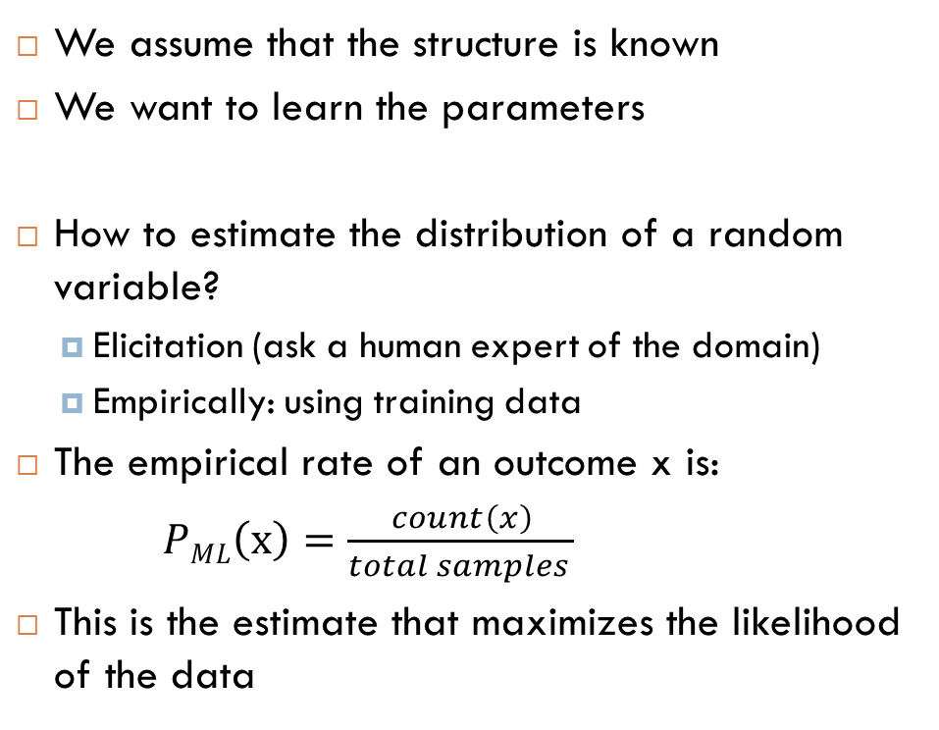
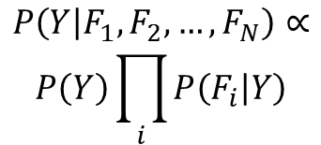
Naïve Bayes
We assume that the structure is known
We want to learn the parameters
How to estimate the distribution of a random variable?
Elicitation (ask a human expert of the domain)
Empirically: using training data
The empirical rate of an outcome x is:
$PML\left(x\right)=\frac{count\left(x\right)}{total samples }$
This is the estimate that maximizes the likelihood of the data
Y
F₁
F_{n}
F₂
…
$$P\left(Y | F_{1}, F_{2}, …, F_{N}\right)∝$$
$$P\left(Y\right)\prod_{i}{P\left(F_{i} | Y\right)}$$
Notes:
ML: Maximum Likelihood
$∝$ : proportional to

Slide 7
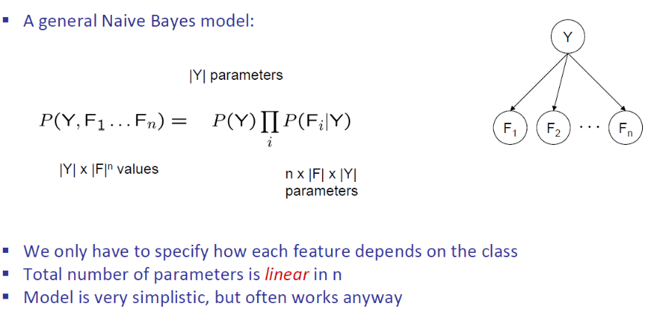
Naïve Bayes

Slide 8
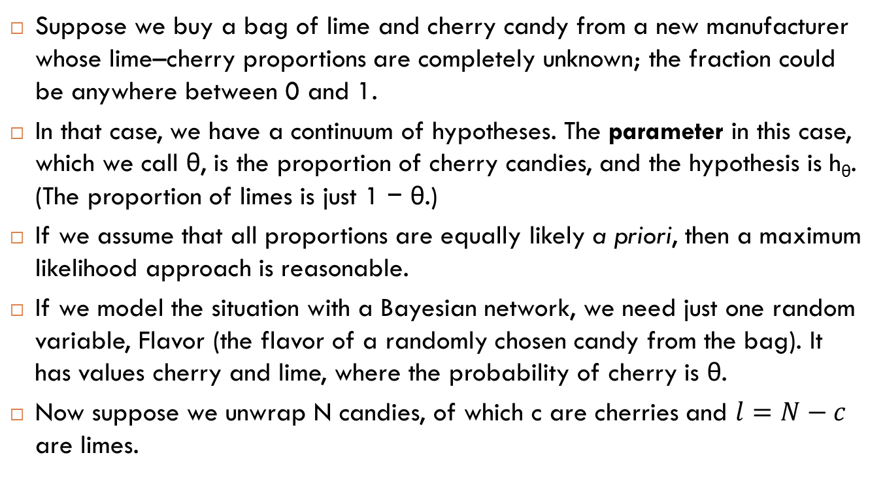
Maximum likelihood estimation – example
Suppose we buy a bag of lime and cherry candy from a new manufacturer whose lime–cherry proportions are completely unknown; the fraction could be anywhere between 0 and 1.
In that case, we have a continuum of hypotheses. The parameter in this case, which we call θ, is the proportion of cherry candies, and the hypothesis is h_{θ}. (The proportion of limes is just 1 − θ.)
If we assume that all proportions are equally likely a priori, then a maximum likelihood approach is reasonable.
If we model the situation with a Bayesian network, we need just one random variable, Flavor (the flavor of a randomly chosen candy from the bag). It has values cherry and lime, where the probability of cherry is θ.
Now suppose we unwrap N candies, of which c are cherries and $l=N−c$ are limes.

Slide 9
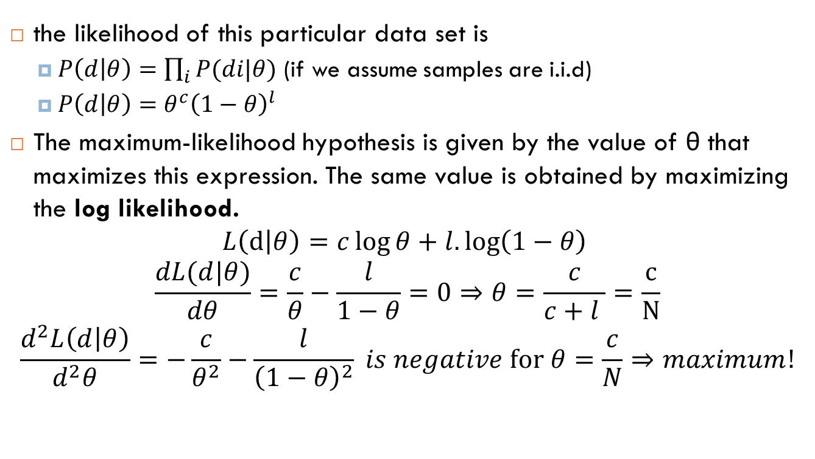
MLE – continue
the likelihood of this particular data set is
$P\left(d | θ\right)=\prod_{i}{P(di|θ)}$ (if we assume samples are i.i.d)
$P\left(d | θ\right)=θ^{c}{\left(1−θ\right)}^{l}$
The maximum-likelihood hypothesis is given by the value of θ that maximizes this expression. The same value is obtained by maximizing the log likelihood.
$$L\left(d | θ\right)=c\log{θ+l.\log\left(1−θ\right) }$$
$$\frac{dL(d|θ)}{dθ}=\frac{c}{θ}−\frac{l}{1−θ}=0⇒θ=\frac{c}{c+l }=\frac{c}{N}$$
$$\frac{d^{2}L\left(d | θ\right)}{d^{2}θ}=−\frac{c}{θ^{2}}−\frac{l}{{\left(1−θ\right)}^{2}} is negative for θ=\frac{c}{N}⇒maximum!$$

Slide 10

Maximum a posteriori
In case where hypotheses do not have equal priors, we have to choose the maximum a posteriori or MAP hypothesis.
$$θ_{MAP}=\underset{θ}{argmax}{P\left(θ | X\right)}{=\underset{θ}{argmax}{P\left(X | θ\right)P\left(θ\right)}}$$

Slide 11
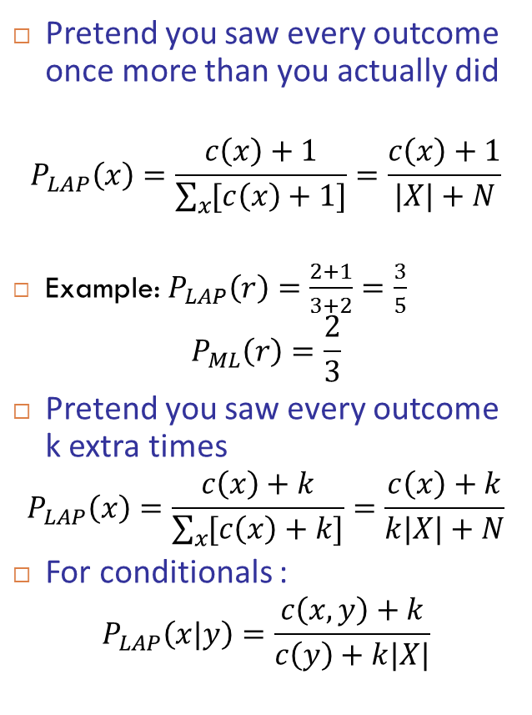
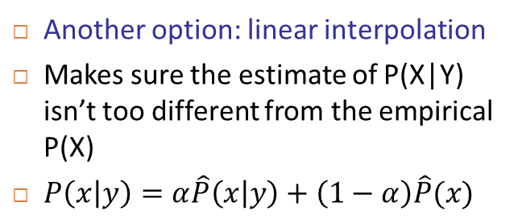
Laplace smoothing / Linear interpolation
Pretend you saw every outcome once more than you actually did
$$P_{LAP}\left(x\right)=\frac{c\left(x\right)+1}{\sum_{x}{[c\left(x\right)+1]}}=\frac{c\left(x\right)+1}{|X|+N}$$
Example: $P_{LAP}\left(r\right)=\frac{2+1}{3+2}=\frac{3}{5}$
$$P_{ML}\left(r\right)=\frac{2}{3}$$
Pretend you saw every outcome k extra times
$$P_{LAP}\left(x\right)=\frac{c\left(x\right)+k}{\sum_{x}{[c\left(x\right)+k]}}=\frac{c\left(x\right)+k}{k|X|+N}$$
For conditionals :
$$P_{LAP}\left(x|y\right)=\frac{c\left(x,y\right)+k}{c\left(y\right)+k|X|}$$
Another option: linear interpolation
Makes sure the estimate of P(X|Y) isn’t too different from the empirical P(X)
$P\left(x | y\right)=α\hat{P}\left(x | y\right)+\left(1−α\right)\hat{P}(x)$
Notes:
For k = inf ; we’ll have a uniform distribution

Slide 12


Slide 13
Spam or ham ?
This is Neil Trotter,the Euro Million lottery winner for 2014.I will like you to help me make some donations to cancer pateints.please Contact me on: neiltrotter101@163.com for more details or read the attachment for more info.

Slide 14
Spam or ham ?
want a tax-free job in Dubai get almost 4 times more pay than your salary email us your resume, if you want job in middle east

Slide 15
Spam or ham?
Dear Dr., When is assignment 2 due to ? Best Regards,

Slide 16
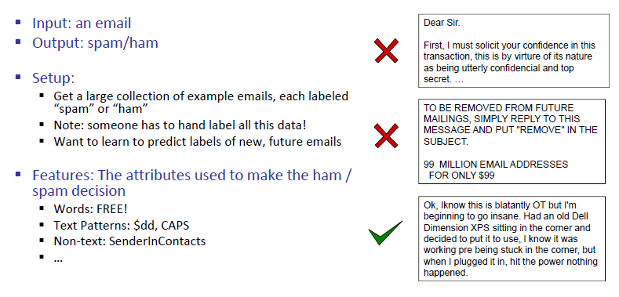
Example: SPAM classification
Notes:
$dd means dollar sign followed by two digits

Slide 17
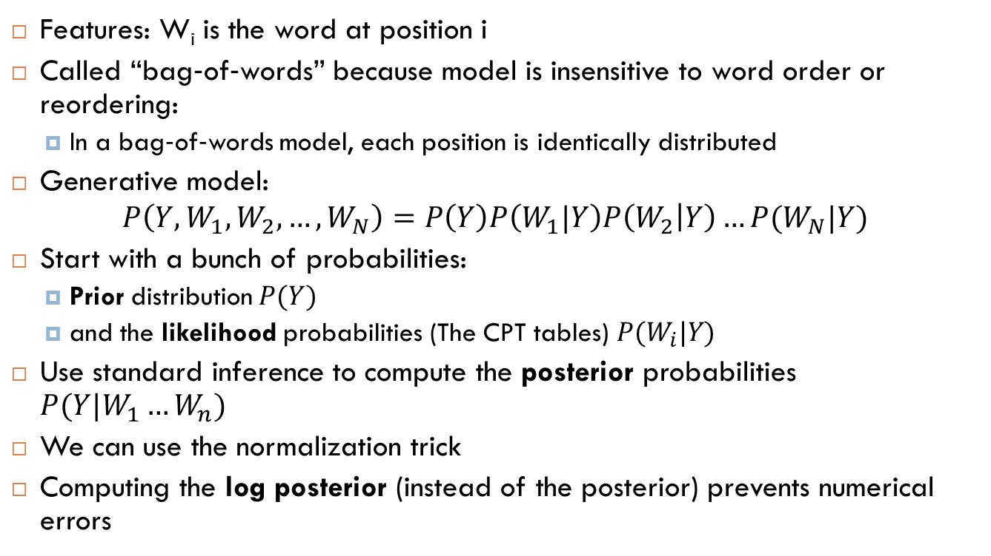
Bag‐of‐words Naïve Bayes:
Features: W_{i} is the word at position i
Called “bag‐of‐words” because model is insensitive to word order or reordering:
In a bag‐of‐words model, each position is identically distributed
Generative model:
$$P\left(Y,W_{1},W_{2},…, W_{N}\right)=P\left(Y\right)P\left(W_{1}|Y\right)P\left(W_{2} | Y\right)…P(W_{N}|Y)$$
Start with a bunch of probabilities:
Prior distribution $P(Y)$
and the likelihood probabilities (The CPT tables) $P(W_{i}|Y)$
Use standard inference to compute the posterior probabilities $P(Y|W_{1}…W_{n})$
We can use the normalization trick
Computing the log posterior (instead of the posterior) prevents numerical errors

Slide 18
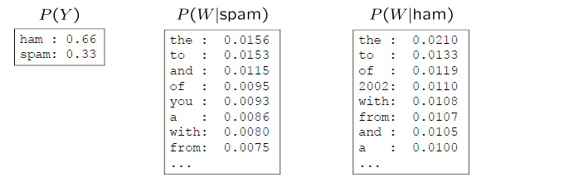
Example
Word | P(w|spam) | P(w|ham) | Total spam (log) | Total ham (log)
(prior) | 0.333 | 0.666 | -1.1 | -0.4
The | 0.005 | 0.013 | -5.27 | -4.27
Year | … | … | … | …
2002
…
Notes:
The decision is SPAM if total Spam > total Ham
Here we use log base e but any other log would be good

Slide 19
Advanced SPAM filters
Known Spamming IP ?
Have you emailed this person before ?
Have 1000 other people received the same message ?
Is Email header consistent ? (e.g. From header is consistent with IP address)
ALL CAPS ?
Do inline URLs point to where they say ?
Are you addressed by your real name ?
Emails are labeled by end-users!

Slide 20
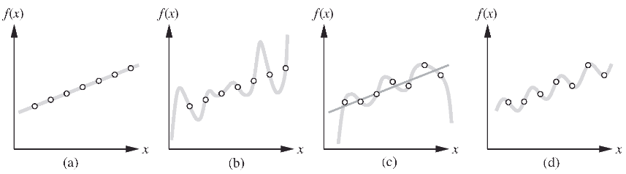
Generalization vs overfitting
A fundamental problem in inductive learning: how do we choose from among multiple consistent hypotheses?
One answer is to prefer the simplest hypothesis consistent with the data. This principle is called Ockham’s razor, after the 14th-century English philosopher William of Ockham, who used it to argue sharply against all sorts of complications.
Defining simplicity is not easy, but it seems clear that a degree-1 polynomial is simpler than a degree-7 polynomial

Slide 21
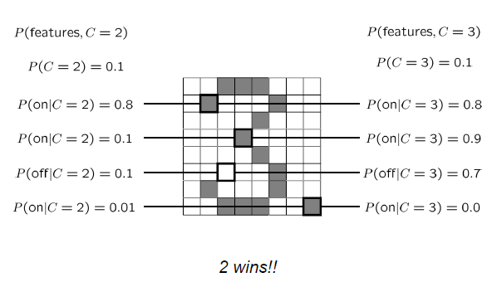
Example overfitting
To generalize better: we need to smooth or regularize the estimates

Slide 22
Train/validate/test
We usually divide our data set into three parts:
The larger part is used for training. E.g. learn priors and CPTs.
The remaining data are divided into two sets; one for validation (or held-out) and one for testing
In validation, we assess the performance of our trained model on the validation set. This allows us to tune our model hyperparameters: e.g. the amount / type of smoothing to do, removing or adding features, etc.
This cycle can be repeated many times
The test set is only used at the end to assess the real performance of our trained model

Slide 23

Exercise : MLE Binomial distribution
Given samples 0, 1, 0, 0, 1, 0 from a binomial distribution
Which has the form $P(X=0) = (1−μ)$, $P(X=1) =μ$
What is the maximum likelihood of $μ$ ?

Slide 24

Exercise MLE Poisson distribution
Given samples, 5, 9, 3, 12, 14 from a Poisson distribution,
which has the form
$$P\left(X=k\right)=\frac{λ^{k}e^{−λ}}{k!}$$
What is the maximum likelihood estimate of $λ$

Slide 25
Laplace for single variable distribution
Given: a1, a2, a1, a2, a3, a1, a3, a2
What are the Laplace-k smoothed estimate of P(A) with domain of A = {a1, a2, a3} for k=1
P(A=a1)=?
P(A=a2)=?
P(A=a3)=?
Same question for k=2
Notes:
4/11; 4/11; 3/11
5/14 ; 5/14; 4/14

Slide 26
Laplace for conditional distribution
Given (a1, b1), (a2,b2), (a1, b2), (a1,b3), (a2, b2), (a1,b1)
What are the Laplace-k estimates for P(B|A), for k=3
P(B=b1|A=a1) = ?
P(B=b2|A=a1) = ?
P(B=b1|A=a2) = ?
P(B=b2|A=a2)= ?
P(B=b3|A=a1) = ?
P(B=b3|A=a2)= ?

Slide 27
Bag of words exercise
Spam messages:
Offer is secret
Click secret link
Secret sports link
Ham messages:
Play sports today
Went play sports
Secret sports event
Sports is today
Sports costs money
Size of vocabulary= ?
P(SPAM) = ?
P_{ML}(“Secret”|SPAM) = ?
P_{ML}(“Secret”|HAM)=?
how many parameters to represent the Naïve Bayes Network?
P(SPAM|”Sports”)=?
P(SPAM| “Secret is secret”) = ?
P(SPAM|”Today is secret”)=?
Notes:
12, 3/8, 3/9, 1/15, 23, 1/6, 25/26, 0

Slide 28
Bag of words – Laplace smoothing
Using Laplace smoothing with K=1 for the following datasets, compute P(SPAM)
1 message, 1 SPAM
10 messages, 6 SPAM
100 messages, 60 SPAM
Notes:
2/3; 7/12; 61/102

Slide 29
Bag of words – Laplace smoothing
Spam messages:
Offer is secret
Click secret link
Secret sports link
Ham messages:
Play sports today
Went play sports
Secret sports event
Sports is today
Sports costs money
K=1
P(SPAM) = ?
P(HAM)=?
P(“TODAY”|SPAM) =?
P(“TODAY”|HAM) =?
M=“Today is secret”
P(SPAM|M) = ?
Notes:
0.4, 0.6, 0.0476, 0.0740, 0.485

Slide 30
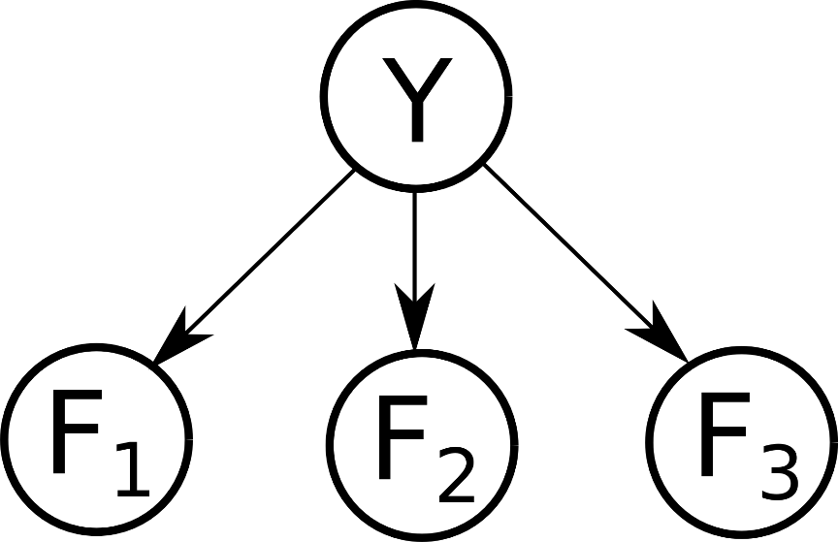
Exercise
In this question, we will train a Naive Bayes classifier to predict class labels Y as a function of input features Fi.
We are given the following 15 training points:
F1 | 1 | 1 | 1 | 0 | 1 | 0 | 1 | 1 | 0 | 0 | 1 | 1 | 0 | 0 | 1
F2 | 0 | 0 | 0 | 0 | 0 | 0 | 0 | 0 | 0 | 1 | 0 | 0 | 0 | 0 | 0
F3 | 0 | 0 | 0 | 0 | 0 | 0 | 0 | 0 | 0 | 0 | 1 | 1 | 1 | 1 | 1
Y | A | A | A | A | A | A | A | A | A | A | B | B | B | C | C

Slide 31
Exercise – continue
What is the maximum likelihood estimate of the prior P(Y)?
What are the maximum likelihood estimates of the conditional probability distributions?
Now consider a new data point (F1=1, F2=1, F3=0). Use your classifier to determine the joint probability of causes Y and this new data point, along with the posterior probability of Y given the new data.
What label does your classifier give to the new data point?
F1 | 1 | 1 | 1 | 0 | 1 | 0 | 1 | 1 | 0 | 0 | 1 | 1 | 0 | 0 | 1
F2 | 0 | 0 | 0 | 0 | 0 | 0 | 0 | 0 | 0 | 1 | 0 | 0 | 0 | 0 | 0
F3 | 0 | 0 | 0 | 0 | 0 | 0 | 0 | 0 | 0 | 0 | 1 | 1 | 1 | 1 | 1
Y | A | A | A | A | A | A | A | A | A | A | B | B | B | C | C

Slide 32
Exercise – continue
Now use Laplace Smoothing with strength k = 2 to estimate the prior P(Y) for the same data.
Use Laplace Smoothing with strength k = 2 to estimate the conditional probability distributions below.
Now consider again the new data point (F1=1, F2=1, F3=0). Use the Laplace-Smoothed version of your classifier to determine the joint probability of causes Y and this new data point, along with the posterior probability of Y given the new data.
What label does your (Laplace-Smoothed) classifier give to the new data point?
F1 | 1 | 1 | 1 | 0 | 1 | 0 | 1 | 1 | 0 | 0 | 1 | 1 | 0 | 0 | 1
F2 | 0 | 0 | 0 | 0 | 0 | 0 | 0 | 0 | 0 | 1 | 0 | 0 | 0 | 0 | 0
F3 | 0 | 0 | 0 | 0 | 0 | 0 | 0 | 0 | 0 | 0 | 1 | 1 | 1 | 1 | 1
Y | A | A | A | A | A | A | A | A | A | A | B | B | B | C | C

Slide 33
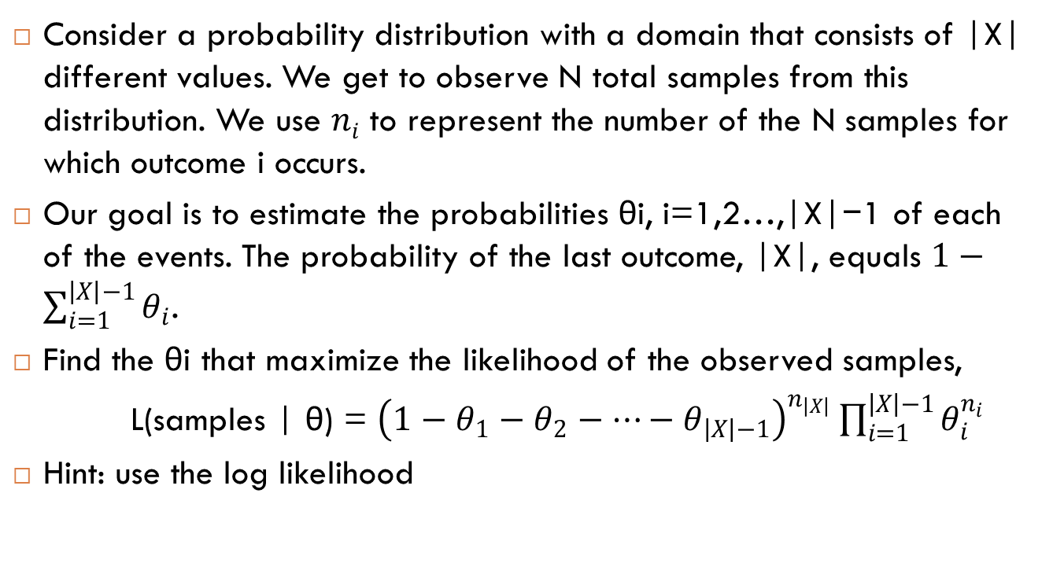
MLE exercise
Consider a probability distribution with a domain that consists of |X| different values. We get to observe N total samples from this distribution. We use $ni$ to represent the number of the N samples for which outcome i occurs.
Our goal is to estimate the probabilities θi, i=1,2…,|X|−1 of each of the events. The probability of the last outcome, |X|, equals $1−\sum_{i=1}^{\left|X\right|−1}{θ_{i}}$.
Find the θi that maximize the likelihood of the observed samples,
L(samples | θ) = ${\left(1−θ_{1}−θ_{2}−…−θ_{\left|X\right|−1}\right)}^{n_{\left|X\right|}}\prod_{i=1}^{\left|X\right|−1}{θ_{i}^{n_{i}}}$
Hint: use the log likelihood

Slide 34
MLE exercise – cnt.
Consider a sampling process with 3 possible outcomes: R, G, and B. We observe the following sample counts:
What is the total sample count N?
What are the maximum likelihood estimates for the probabilities of each outcome?
Use Laplace smoothing with strength k=2 to estimate the probabilities of each outcome.
What are the estimated probabilities if we consider Laplace smoothing in the limit k→∞.
outcome | R | G | B
count | 13 | 2 | 4

